Slide 1
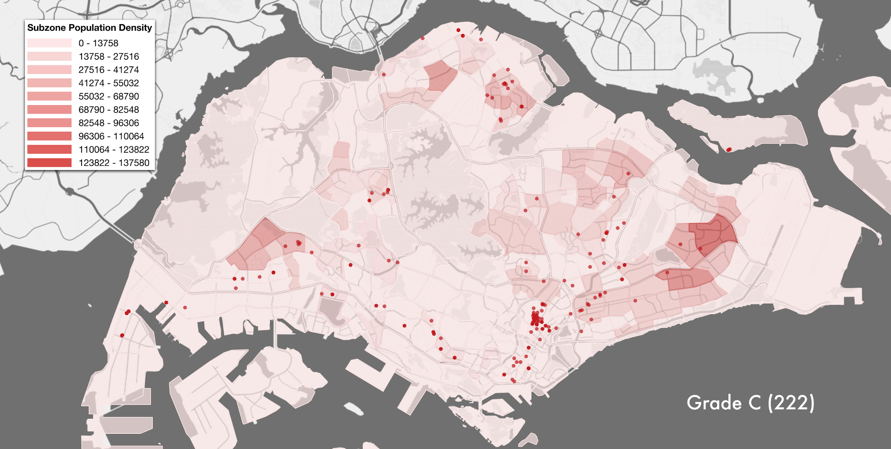
Visualisation with ggplot

Slide 2
Lesson plan
1. Why Visualise?
2. Why ggplot? Introducing the Grammar of Graphics Concept
3. ggplot in action
4. Build your own

Slide 3
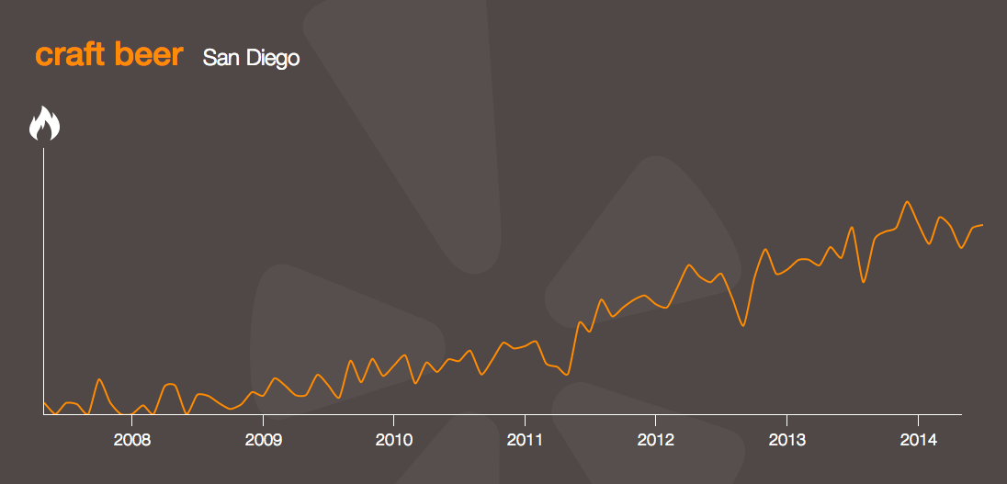
why visualise?
Communicate findings
Understand distributions and relationships
Combined with transforming data with dplyr, key part of exploratory data analysis (EDA)

Slide 4
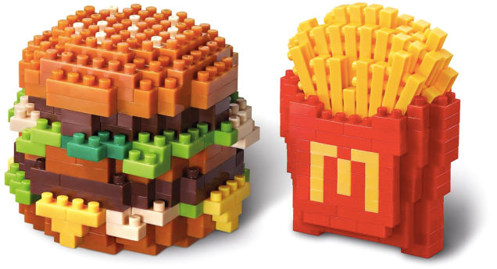
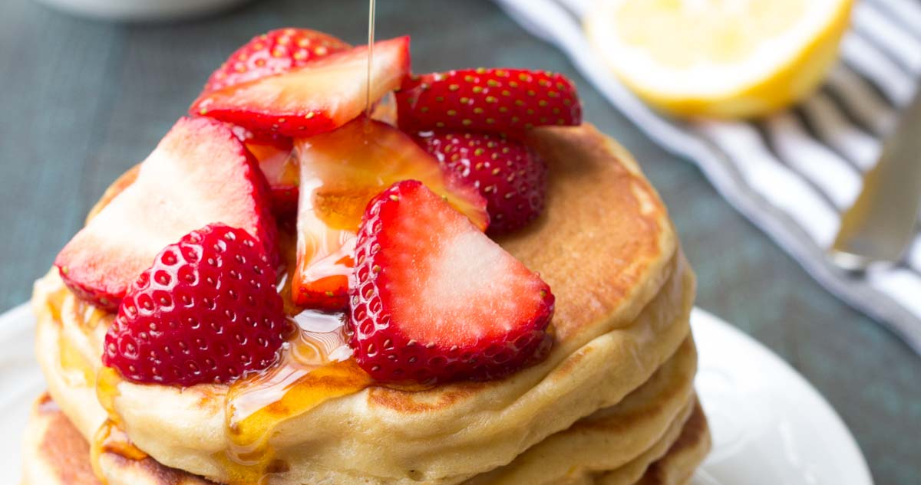
Ggplot2 = legos + pancakes
Legos : build graphs with fundamental building blocks
Pancakes: layer building blocks, on top of each other, to create more complex graphs
Lets look at an example..

Slide 5
To extend the food analogy: cookbook for r by winston chang
#create some data
dat <- data.frame(time = factor(c("Lunch","Dinner"), levels=c("Lunch","Dinner")), total_bill = c(14.89, 17.23))
dat
time total_bill
1 Lunch 14.89
2 Dinner 17.23
# Load the ggplot2 package
library(ggplot2)

Slide 6
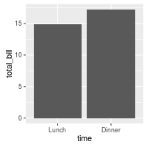
A very basic bar graph
# Very basic bar graph
ggplot(data=dat, aes(x=time, y=total_bill)) +
geom_bar(stat="identity")
Base layer
2nd layer

Slide 7
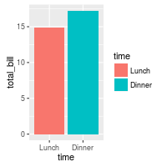
A very basic bar graph
# Map the time of day to different fill colors
ggplot(data=dat, aes(x=time, y=total_bill, fill=time))
+ geom_bar(stat="identity")

Slide 8
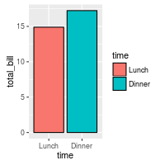
A very basic bar graph
# Add a black outline
ggplot(data=dat, aes(x=time, y=total_bill, fill=time)) + geom_bar(colour="black", stat="identity")

Slide 9
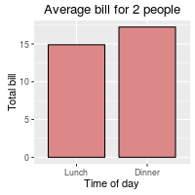
More sophisticated layering
ggplot(data=dat, aes(x=time, y=total_bill, fill=time))
+ geom_bar(colour="black", fill="#DD8888", width=.8, stat="identity")
+ guides(fill=FALSE)
+ xlab("Time of day")
+ ylab("Total bill")
+ ggtitle("Average bill for 2 people")

Slide 10
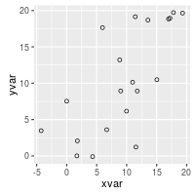
A very basic scatterplot
#create data
set.seed(888)
dat <- data.frame(cond = rep(c("A", "B"), each=10),
xvar = 1:20 + rnorm(20,sd=3),
yvar = 1:20 + rnorm(20,sd=3))
ggplot(dat, aes(x=xvar, y=yvar)) + geom_point(shape=1)
# Use hollow circles

Slide 11
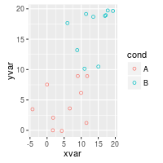
A very basic scatterplot
# Set color by cond
ggplot(dat, aes(x=xvar, y=yvar, color=cond)) + geom_point(shape=1)

Slide 12
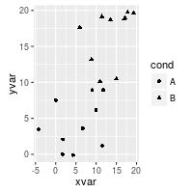
A very basic scatterplot
# Set shape by cond
ggplot(dat, aes(x=xvar, y=yvar, shape=cond))
+ geom_point()

Slide 13
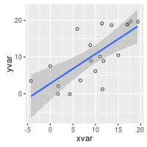
A more sophisticated scatterplot
ggplot(dat, aes(x=xvar, y=yvar))
+ geom_point(shape=1) # Use hollow circles + geom_smooth(method=lm)
# Add linear regression line # (by default includes 95% confidence region)

Slide 14
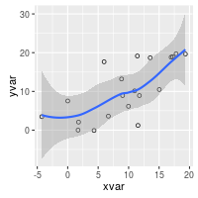
A more sophisticated scatterplot
ggplot(dat, aes(x=xvar, y=yvar))
+ geom_point(shape=1) # Use hollow circles
+ geom_smooth()
# Add a loess smoothed fit curve

Slide 15
Build your own
mother_tongue dataset
1. What questions can you think of?
2. What type of graphs might you plot?

Slide 16
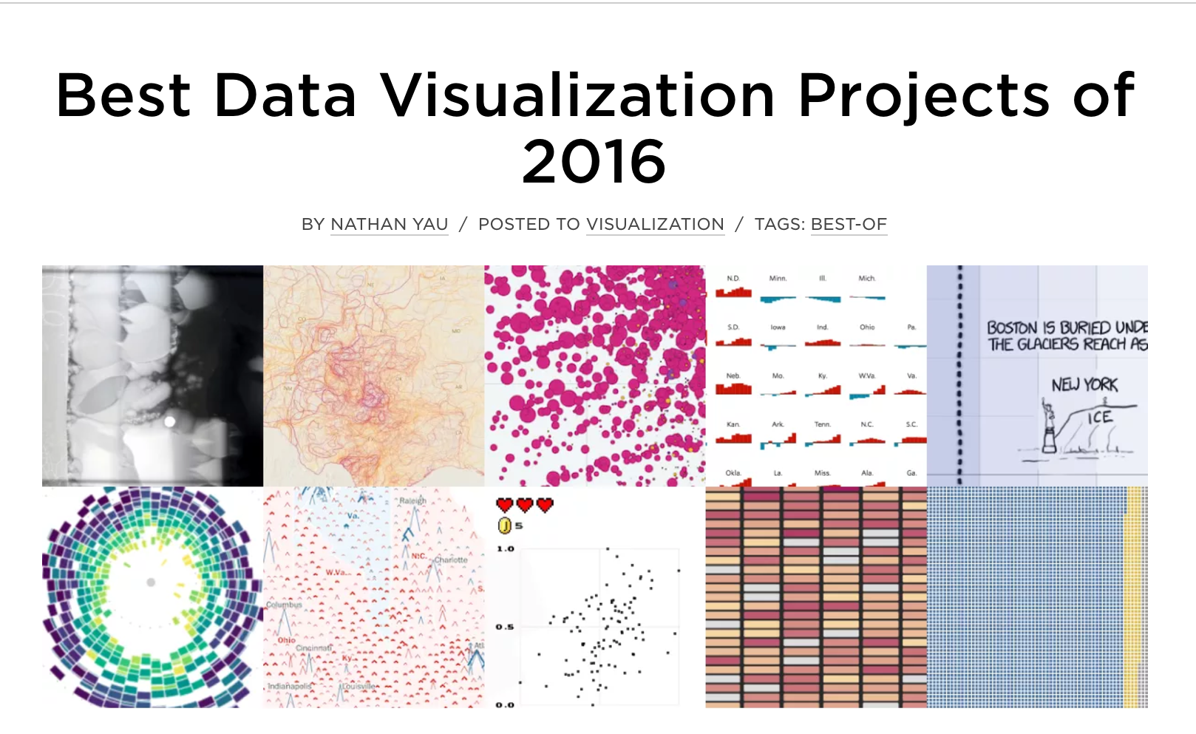
flowingdata.com

